Slide 1
How to write a systematic evaluation & survey paper
-Hanxue Gu 1.13.2022

Slide 2
Where to start
Formulate a research question
What topic/problem you want to deal with
Class imbalance
Small object detection
Object Detection with Deep Learning
…
Consider whether a systematic review is needed before starting your project. Has someone already written one on your topic?
Importance and significance of this topic
Literature review
Distinguish your research with prior work by
Refine this topic (expand it/ narrow it)
dive into this your topic
Note the similarities and differences between a traditional survey
Similarities: based on existing methods/ a lot of literature review/ a taxonomy/
Difference: conclusions come from experimental results/ need to design experiments

Slide 3
goals
Have a comprehensive and organized research based on a certain topic.
Make it easier to follow (have an illustration, or have a section to introduce)
State-of-art view
Logical structure
Ask questions, design experiments and answer your questions based on experimental results.
Have some statements and inform the readers with these conclusions.
Build yourself an understanding of this topic and get some inspirations from these researches

Slide 4
Research steps
Give a clear definition of the problem you want to deal with
Classify your problem into small branches (optional)
Give definition to the small branches.
Choose what experiments you want to design.
Choose which methods you want to include.

Slide 5
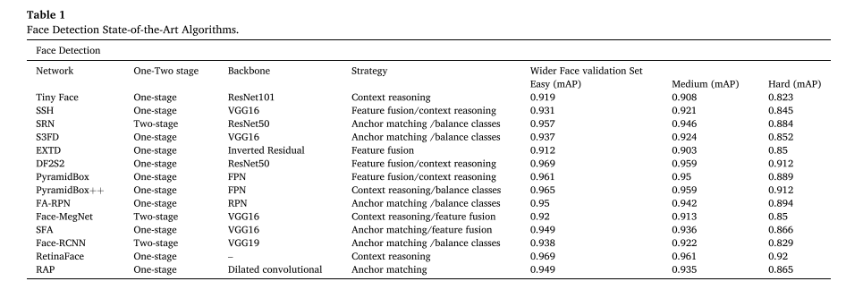
Research steps
Choose which methods you want to include
Like a survey paper
State-of-art methods
Well-known baseline methods, representative
Come from well-known journals/conferences/high citations
Have a clear taxonomy for your selected methods
Brief introduction
Key strategies

Slide 6
How to design experiments
Choose which questions you want to ask
If CNN learn shape?
If imbalance ratio influence performance?
If unreliable labels influence performance?
Start before asking yourself what you want to answer?
If this question related to your topic?
If this question is research meaningful?
Choose want experiments you want to design?
Change parameters based on your questions
Change shape
Change ratio
Change ratio of labels

Slide 7
How to design experiments
How to change parameters
Design datasets
synthetic datasets: easy to control parameters, dataset size, object number, ratio, shape… / no real
Real datasets: well-known, clear and easy to introduce / hard to manipulate.
If there are several parameters, change a single parameter each time.
The controlling of variable is an important scientific inquiry method.
How to get statements
Based on experimental results (based on data, not bias, not first impressions.)
Should not based on a single experiment
change some irrelevant parameters
My suggestion: Start from synthetic -> get statements -> real datasets evaluate

Slide 8
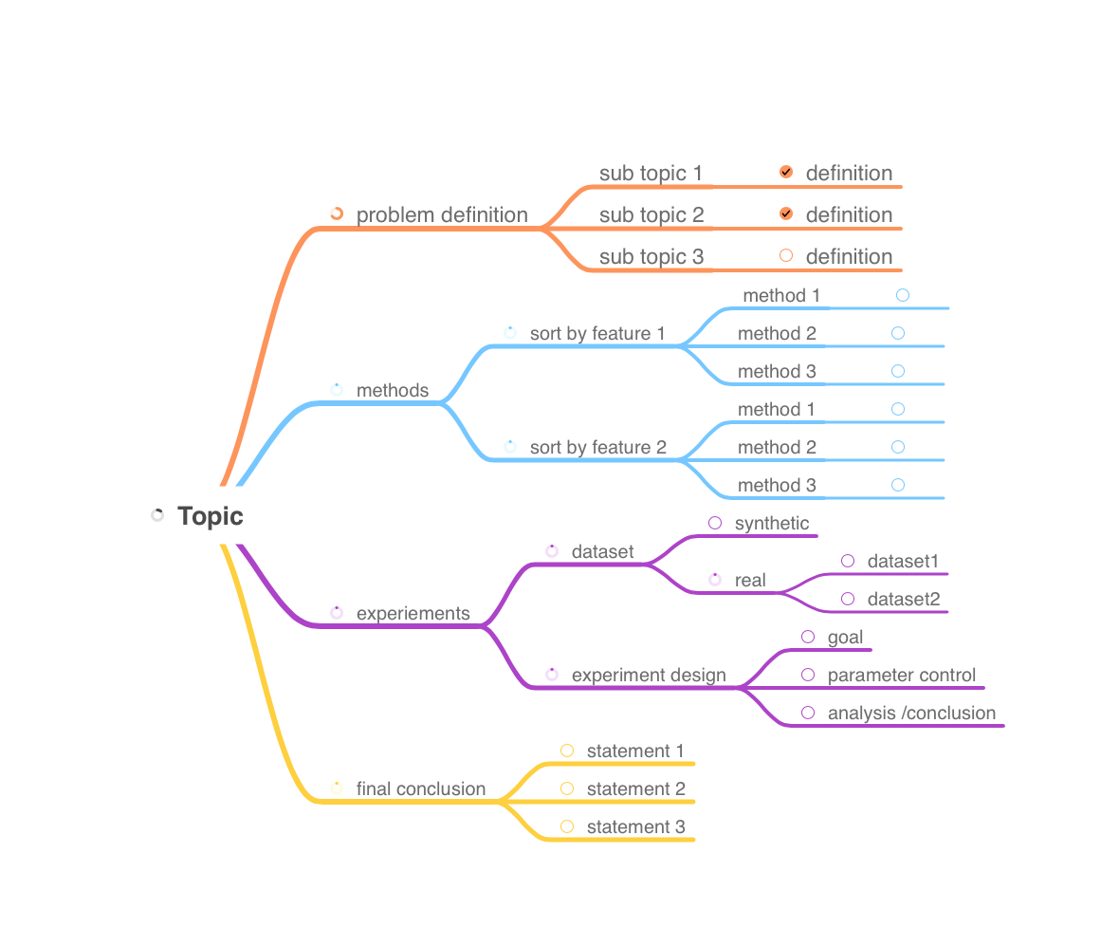
Final structure
Use a mindmap software to have the whole picture in mind.
To do list / done / next steps

